Slide 1
CodeStorm 2024: The Ultimate 36 Hours Hackathon Challenge Innovate. Code. Dominate.
Team Name: Amateur Coders
Project Title: Automated Vehicle and Property Insurance
Theme: Artificial Intelligence
College Name: Indian Institute of Technology, Madras and Chaitanya Deemed to be University
Team Members: Ashok Suthar - 9618531809
Imran Shaikh - 8976605190
Yash Sharma - 9636270876
Gautam - 7989585557

Slide 2
Problem Statement
Traditional damage assessment & claim processing in vehicle & property insurance aren’t just slow they’re also full of labor and make mistakes. This leads to delays & going up.
Because of these issues, claims take longer to resolve. Customers get less satisfaction, while insurance companies face more operational burdens.
There’s a pressing need for an AI-powered solution to make the claims process smoother. We need less manual inspections. Plus, improving accuracy & speed in damage assessments and cost estimations is super important.

Slide 3
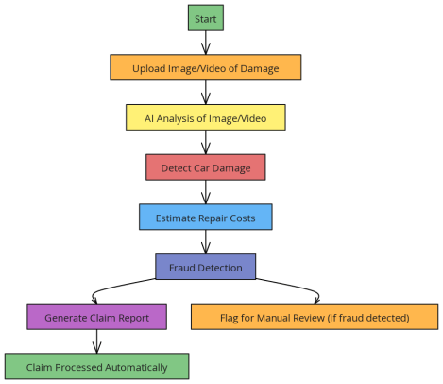
Proposed Solution
We propose an Artificial intelligence-powered model which
Using computer vision(Object Detection and Segment Detection) to access the damage
Estimating the Repair Cost and integrating into the Insurance system
Real Time video Camera Inspection if needed.
A chatbot with all car and Insurance required Queries.

Slide 4
Technology Stack
Tech Stack
Frontend: HTML, CSS, Javascript,React.js
Python
Computer Vision
Tensorflow
PostgreSQL, MongoDB
Google Cloud and Gemini API
Unique Selling
Using Computer vision and custom Yolo v8 and segment detection for accurate damage detection
Fraud Detection in Insurance through Anomaly detection
Real Time video call
Fast Claims and less Physical Inspection
Interactive Chatbot about Insurance

Slide 5
Team Members' Roles
Ashok Suthar: Artificial Intelligence Model-Uses Deep Learning to create a model that can detect, segment damage, and estimate cost.
Yash Sharma: Video Call- Building a Video call system so the inspector can inspect the car in real time.
Imran Shaikh: Frontend- Designing the Website and creating the functionality and frontend.
Gautam: Insure Bot- A Chatbot that can answer any query about Insurance and Cars.

Slide 6
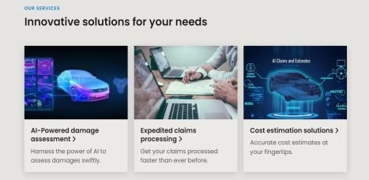
Timeline
This is the basic outline of the whole project development.
1. Planning & Setup (Hour 1-2)
2. Backend & Frontend Setup (Hour 3-6)
3. Object Detection (Hour 7-12)
4. Repair Cost Estimation (Hour 13-17)
5. Real-Time Video Inspection (Hour 18-22)
6. Chatbot Development (Hour 23-28)
7. Insurance System Integration (Hour 29-32)
8. Testing & Deployment (Hour 33-35)
Prototype:
https://automated-vehicle-and-property-insurance.b12sites.com/index

